Slide 1

A project on Predicting Employee Turnover
Made by:
Harshit Gupta, Shobhit Srivastava, Deepak Kumar, Tamal Banerjee

Slide 2

Will the employee leave the organization ?
A serious problem of concern for the organizations.

Slide 3
What is employee turnover?
Employee turnover refers to the percentage of workers who leave an organization and are replaced by new employees.
It is very costly for organizations, where costs include but not limited to: separation, vacancy, recruitment, training and replacement.

Slide 4
Why is it a problem?
On average, organizations invest between four weeks and three months training new employees.
This investment would be a loss for the company if the new employee decided to leave the first year.
Furthermore, organizations such as consulting firms would suffer from deterioration in customer satisfaction due to regular changes in Account Repsand/or Consultants that would lead to loss of businesses with clients.

Slide 5
What have we done?
We have worked on simulated HR data from kaggle to build a classifier that helps us predict what kind of employees will be more likely to leave given some attributes.
Such classifier would help an organization predict employee turnover and be pro-active in helping to solve such costly matter.

Slide 6
How we have have done?
We have restricted ourselves to use the most common classifiers:
Random Forest
Gradient Boosting Trees
K-Nearest Neighbors
Logistic Regression
Support Vector Machine.

Slide 7
About the dataset
The data has 14,999 examples (samples). Below are the features and the definitions of each one:
satisfaction_level: Level of satisfaction {0–1}.
last_evaluationTime: Time since last performance evaluation (in years).
number_project: Number of projects completed while at work.
average_montly_hours: Average monthly hours at workplace.
time_spend_company: Number of years spent in the company.
Work_accident: Whether the employee had a workplace accident.
left: Whether the employee left the workplace or not {0, 1}.
promotion_last_5years: Whether the employee was promoted in the last five years.
department: Department the employee works for.
salary: Relative level of salary {low, medium, high}.

Slide 8
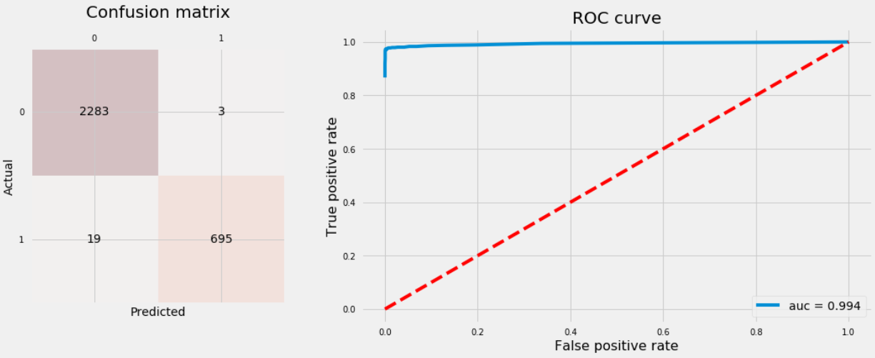
Random Forest

Slide 9
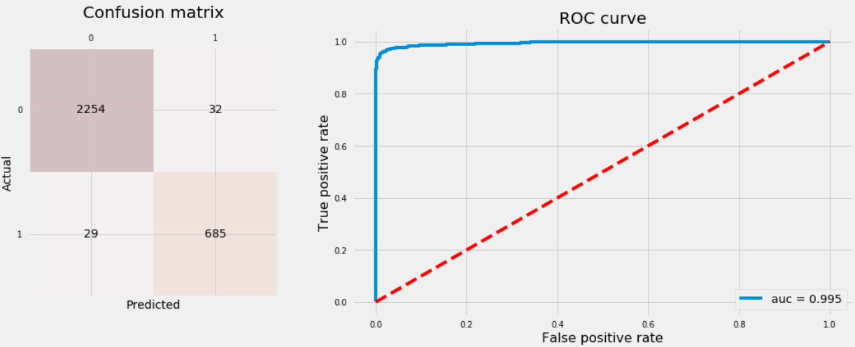
Gradient Boosting Trees

Slide 10

K-Nearest Neighbors

Slide 11
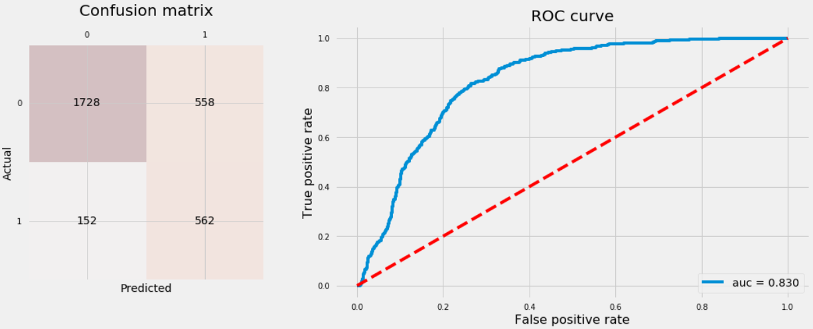
Logistic Regression

Slide 12

Support Vector Machine

Slide 13
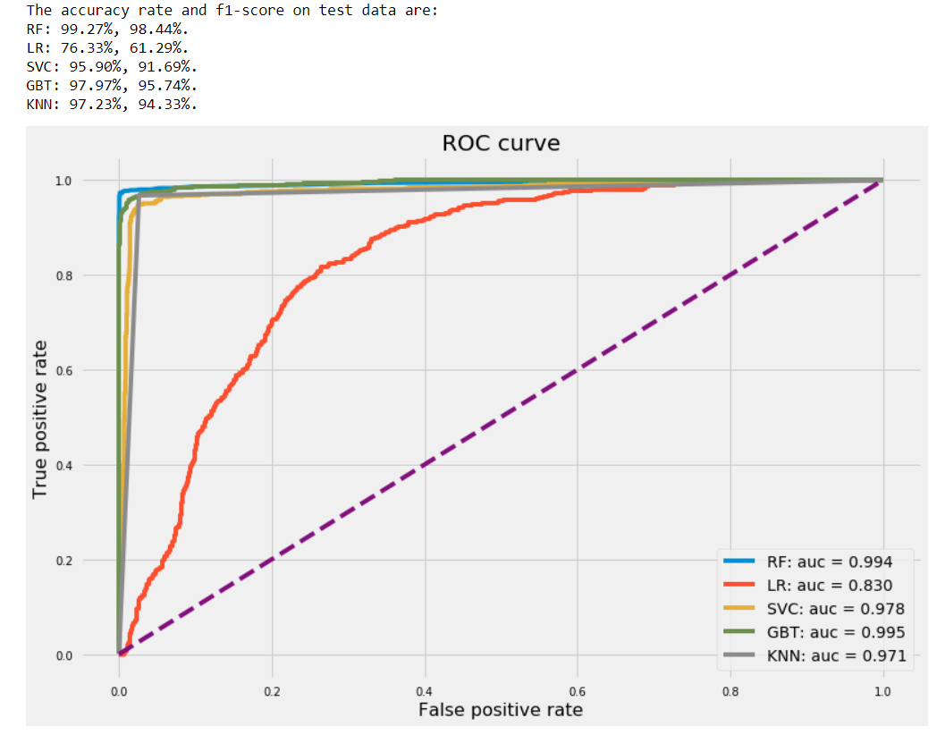
Comparing all classifiers

Slide 14
Even though Random Forest and Gradient Boosting Trees have almost equal AUC, Random Forest has higher accuracy rate and an f1-score with 99.27% and 99.44% respectively. Therefore, we safely say Random Forest outperforms the rest of the classifiers. Let’s have a look of feature importances from Random Forest classifier.

Slide 15
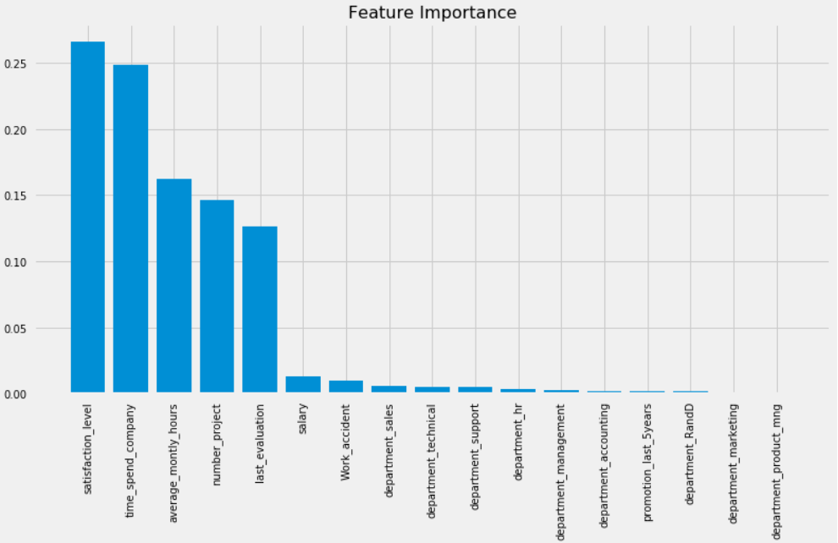
Random forest feature importance

Slide 16
Looks like the five most important features are:
satisfaction_level
time_spend_company
average_montly_hours
number_project
lats_evaluation

Slide 17
Building the GUI
Python offers multiple options for developing GUI (Graphical User Interface). Out of all the GUI methods, tkinter is most commonly used method. It is a standard Python interface to the Tk GUI toolkit shipped with Python. Python with tkinter outputs the fastest and easiest way to create the GUI applications. Creating a GUI using tkinter is an easy task.

Slide 18
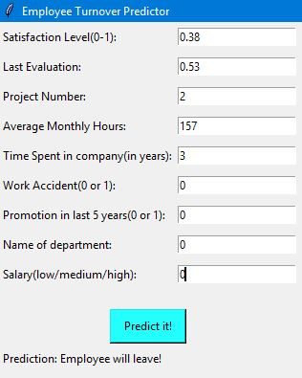
Predicting positive output

Slide 19
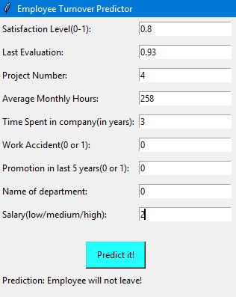
Predicting negative output

Slide 20
Project Made by:
Harshit Gupta (Batch-1)
Shobhit Srivastava (Batch-1)
Deepak Kumar (Batch-1)
Tamal Banerjee (Batch-1)

